Slide 1
Weterings Plastics
A Hexatronic company, part of the family since 2021

Slide 2
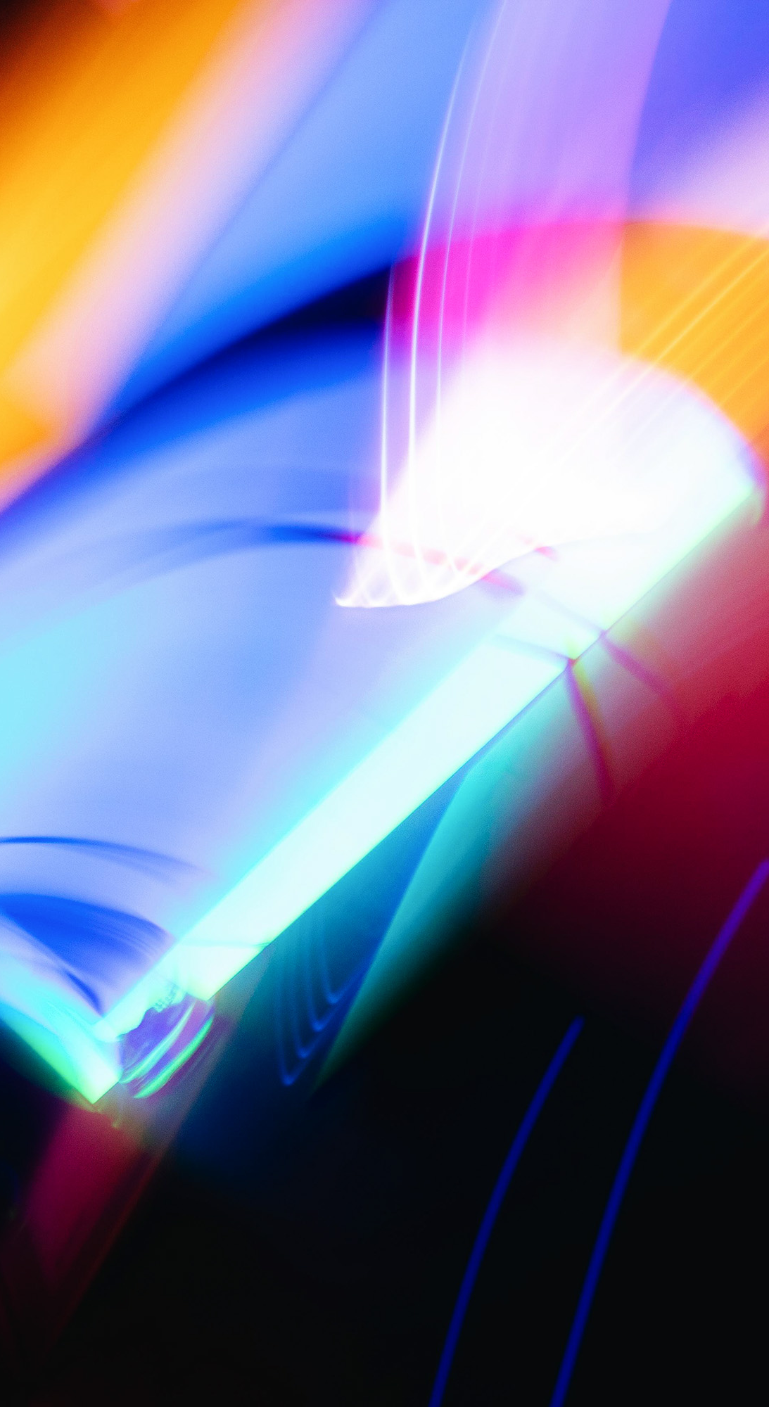
The next 45 minutes:
About Weterings and bigger ducts
Sustainability
Greenline Products 25-63mm
How its made
How its sold
Quality
Wrap up: survival kit
Questions?

Slide 3


Different materials to work with
Certified Post Consumer Recycling
Plastics that has been something else before
Up-cycling
Certified EN15343:2007
Unique material in Telecom
Recycling
Own productions waste
Production waste from others
Most companies can use limited % in current products
Unique: Weterings up to 100%
Virgin
Compared to other applications of plastics quite sustainable
Improved sustainability: miniaturization

Slide 4

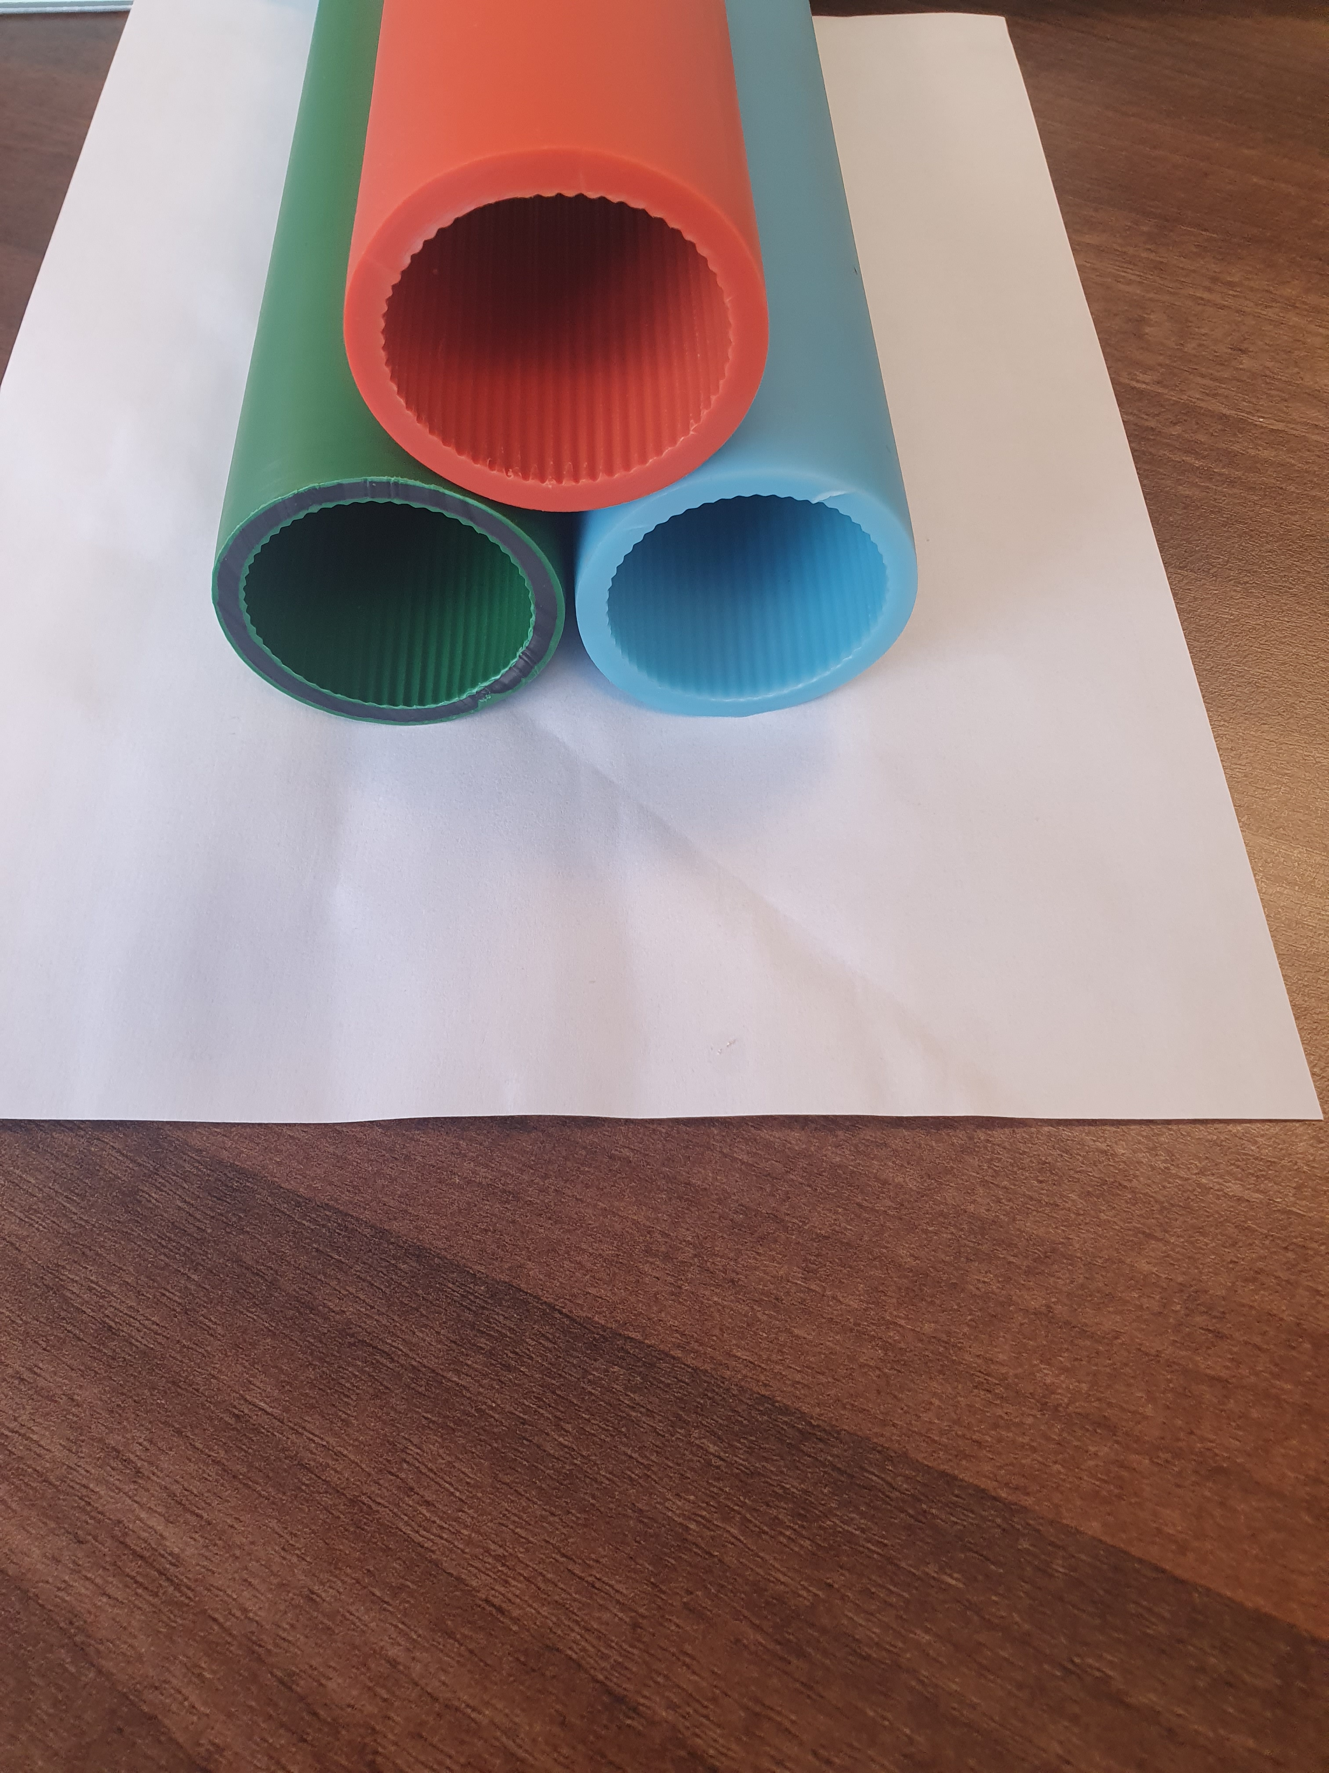
Three layer technology
Outer/ identification: colour + posible stripe
Middle/ filler: protective propperties (67%)
Inner: ribs for blowingperformance
4 types products
Greenline
Recycled
Recycled
Recycled
ECO-Duct
Virgin
P.C.-Recycled (black)
Virgin
Greenline ECO-Duct
Recycled
P.C.-Recycled (black)
Recycled
Virgin
Virgin
Virgin
Virgin
Sizes: 20 – 25 – 32 – 40 – 50 – 63 mm
Autumn: 20+25 with LF Inner layer
LSZH: only in 100% virgin
Packaging: coils, reels, skeleton reels

Slide 5

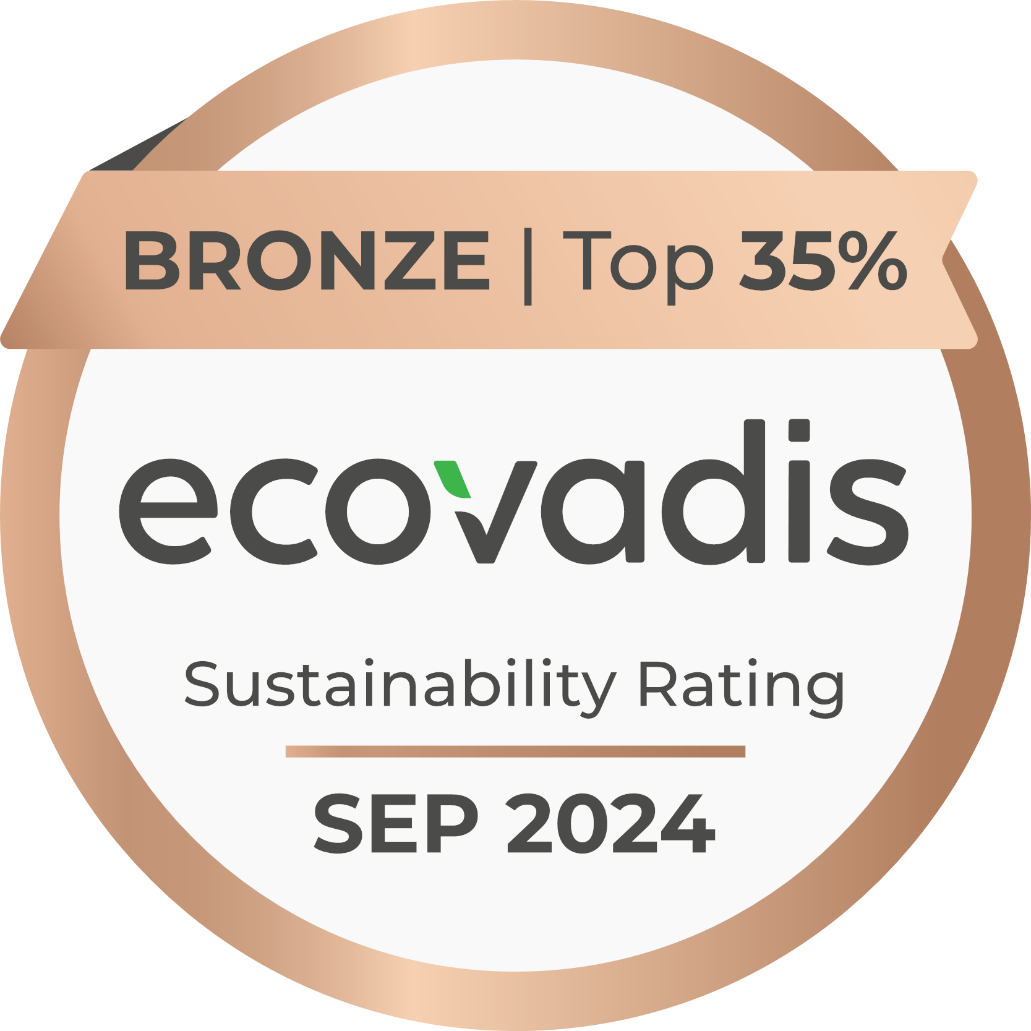

Greenline promisse:
no need for virgin materials in our products
today, half of all materials in production are recycling:
    44% Certified Post Consumer recycling
    6% other recycling grades
  No fosile fuels for production process
  ...Weterings is best in class in sustainability
Larger ducts are heavier: easier to meet sales budget

Slide 6
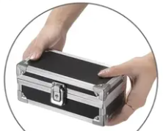
Survival-kit
To each company we send an easy-to-handle survival kit to be used during customer visits
Contains:
Samples of different ducts
Evidence to support sustainability claims
Packaging information
Data sheet
Blowing performance reference
Copy of this presentation
Your product pricing
Pricing logistics
Sales-questions-checklist
Life jacket: how to get support from our team

